Slide 1
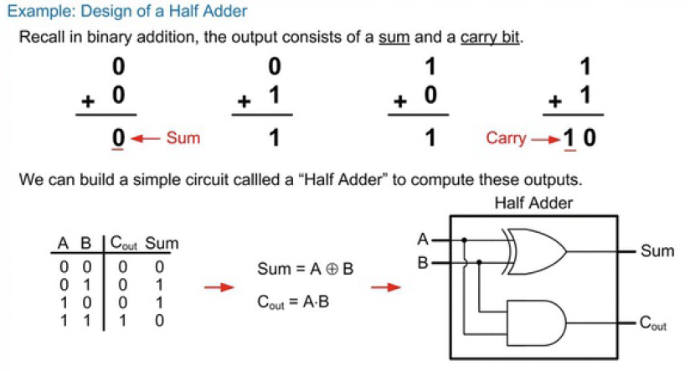
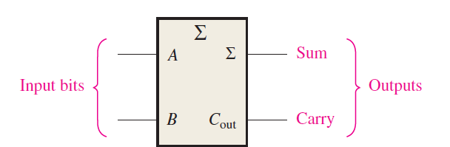
Half adder
The half-adder accepts two binary digits on its inputs and produces two binary digits on its outputs—a sum bit and a carry bit.
Logic symbol for a half-adder

Slide 2
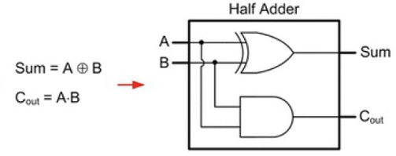
Verilog Code for Half adder
module Half(A,B,SUM,COUT);
input A,B;
output SUM,COUT;
assign SUM = A ^ B;
assign COUT = A & B;
endmodule

Slide 3
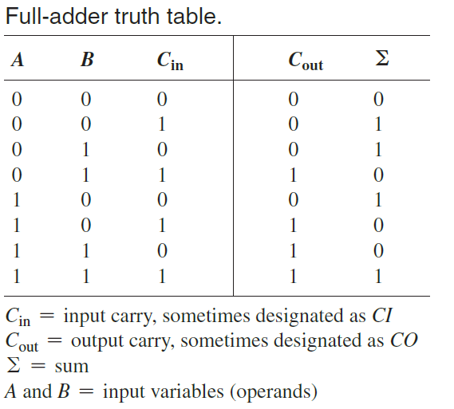
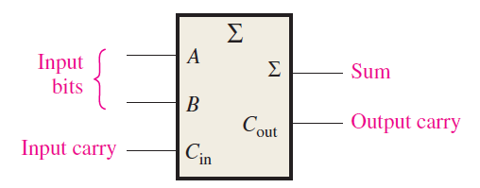
Full adder
The full-adder accepts two input bits and an input carry and generates a sum output and an output carry.
Logic symbol for a full-adder

Slide 4


Full adder
The full adder must add the two input bits and the input carry.
From the half-adder, the sum of the input bits A and B is the exclusive-OR of those two variables
For the input carry (Cin) to be added to the input bits, it must be exclusive-OR’d with A XOR B, yielding the equation for the sum output of the full-adder
The output carry of the full-adder is therefore produced by input A ANDed with input B and A XOR with B ANDed with Cin. These two terms are Ored
This function is implemented and combined with the sum logic to form a complete full-adder circuit

Slide 5
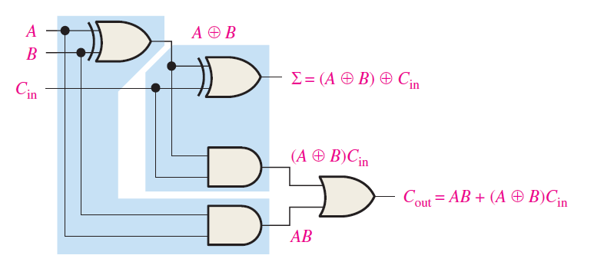
Full adder
Complete logic circuit for a full-adder (each half-adder is enclosed by a shaded area)
Two half-adders with their output carries ORed to form the full-adder.

Slide 6
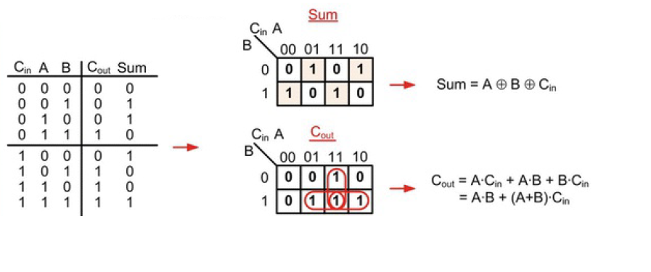
Full adder

Slide 7
Verilog Code for Full adder
module FA(A,B,Cin,Sum,Cout);
input A, B, Cin;
output Sum, Cout;
assign Sum = A ^ B ^ Cin;
assign Cout = (A&B) | ((A ^ B)&Cin));
endmodule

Slide 8
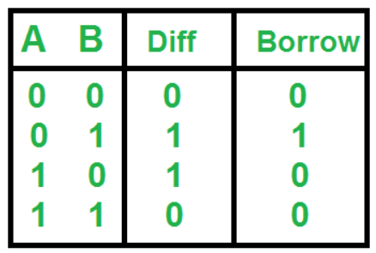
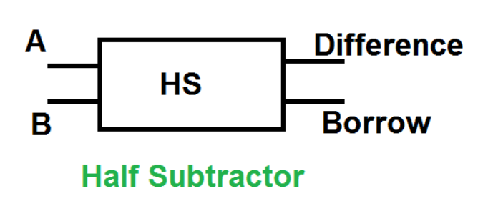
Half subtractor
A half subtractor is a digital logic circuit that performs the binary subtraction of two single-bit binary numbers. It has two inputs, A (Minuend) and B (Subtrahend), and two outputs, Difference and Borrow. The Difference output represents the result of subtracting B from A, while the Borrow output indicates whether a borrow is needed when A is smaller than B.
Truth Table of Half Subtractor

Slide 9
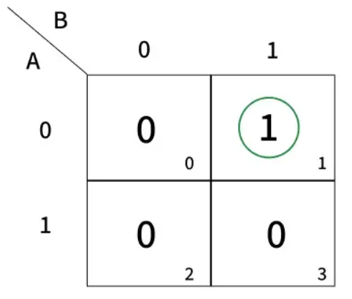
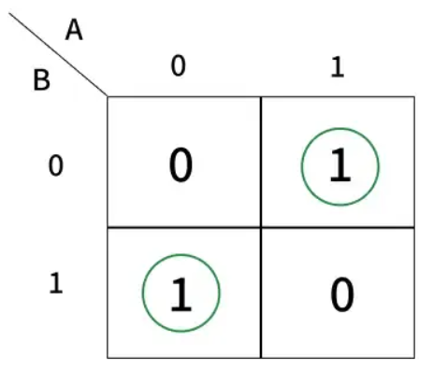
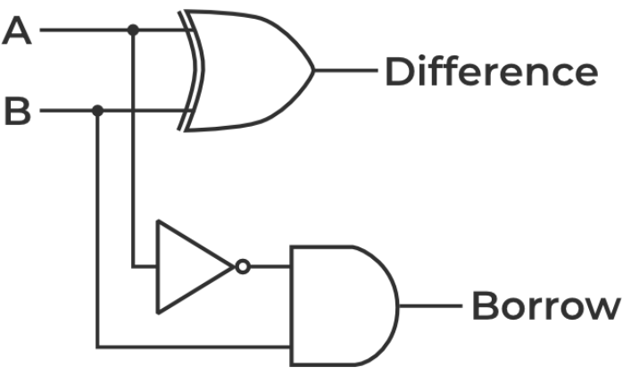
Half subtractor
The SOP form of the Difference is as follows: Difference = A'B+AB’
The SOP form of the Borrow is Borrow = A'B

Slide 10
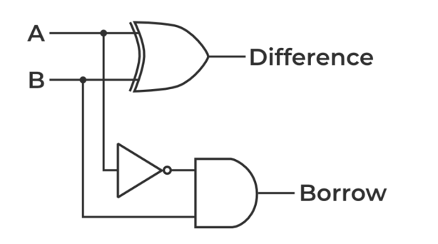
Verilog Code for Half subtractor
module Half(A,B,Difference,Borrow);
input A,B;
output Difference, Borrow;
assign Difference = A ^ B;
assign Borrow = (~A) & B;
endmodule

Slide 11
Full subtractor
A Full Subtractor is a combinational circuit used to perform binary subtraction. It has three inputs:
A (Minuend), B (Subtrahend), B-IN (Borrow-in from the previous stage)
It produces two outputs:
Difference (D): The result of the subtraction.
Borrow-out (B-OUT): Indicates if a borrow is needed for the next stage.
The full subtractor is essential because a half-subtractor can only subtract the least significant bit (LSB) of binary numbers.
However, if a borrow is generated during the subtraction of the LSBs, it will affect the subtraction in the next stages. A full subtractor handles this situation by considering the borrow from the previous stage, ensuring accurate subtraction even when a borrow is present.
The full subtractor is used to subtract binary numbers with borrow handling, making it suitable for multi-bit subtraction in digital circuits like Arithmetic Logic Units (ALUs).

Slide 12
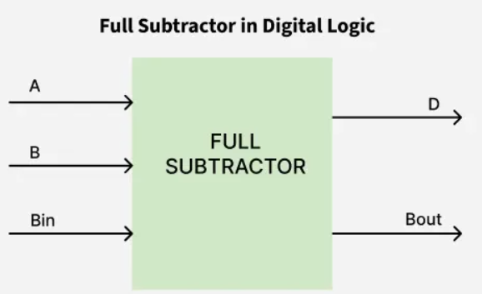
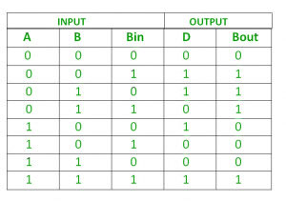
Full subtractor
Truth Table

Slide 13
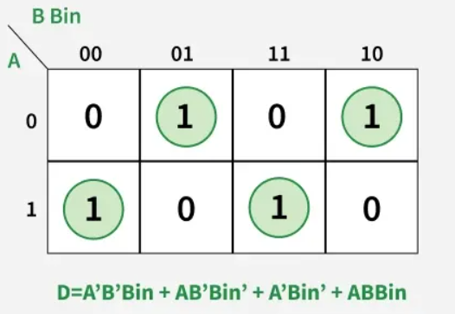
Full subtractor
Recognizing XOR and XNOR properties:
A'B' + AB = A XNOR B AB' + A'B = A XOR B
Substituting these values:
D = Bin(A XNOR B) + Bin' (A XOR B)
Using XNOR identity:
D = Bin ⊕ (A ⊕ B)
Logical expression for the difference
The basic expression is:
D = A'B'Bin + A'BBin' + AB'Bin' + ABBin
Factoring common terms:
D = Bin(A'B' + AB) + Bin'(AB' + A'B)

Slide 14
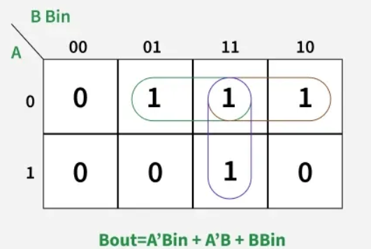
Full subtractor
Logical expression for borrow
The borrow (Bout) output is derived as follows:
Bout = A'B'Bin + A'BBin' + A'BBin + ABBin
Factoring common terms:
Bout = Bin(AB + A'B') + A'B(Bin + Bin’)
Using XOR and XNOR properties:
AB + A'B' = A XNOR B
Substituting these values:
Bout = Bin(A XNOR B) + A’B
Using XNOR identity:
Bout = Bin (A XOR B)' + A'B

Slide 15
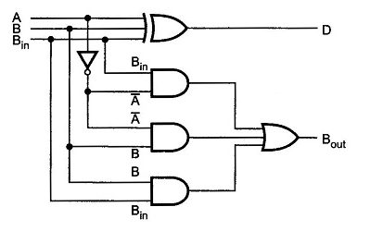
Full subtractor
D = Bin ⊕ (A ⊕ B)
Bout = A'Bin + A'B + BBin

Slide 16
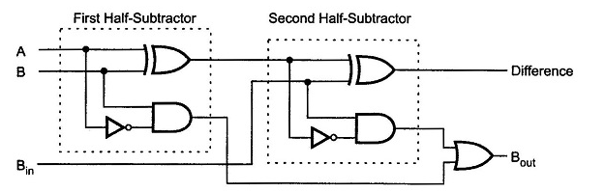
Full subtractor using half substractor
A Full Subtractor can also be implemented with two Half Subtractor and one OR gate
The difference output from the second Half Subtractor is the exclusive-OR of Bin and the output of the first Half Subtractor, (difference output of Full Subtractor)
D = Bin ⊕ (A ⊕ B)
Bout = Bin (A XOR B)' + A'B

Slide 17
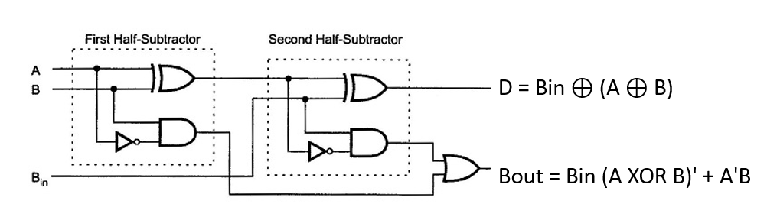
Verilog Code for Full Subtractor
module Fullsubtractor ( input wire A, // Minuend
input wire B, // Subtrahend
input wire Bin, // Borrow in
output wire D, // Difference
output wire Bout // Borrow out );
assign D = A ^ B ^ Bin; // Difference
assign Bout = (~A & B) | (~(A ^ B) & Bin); // Borrow out
endmodule

Slide 18
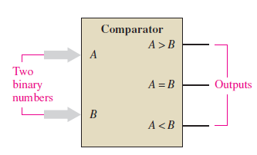
Comparators
Magnitude comparator is a type of Combinational circuit
It compares two binary numbers and determines their relative magnitude.
It gives output whether one number is greater than the other, or less than or equal to.
A comparator receives two N-bit binary numbers A and B and outputs a 1-bit comparison result.

Slide 19
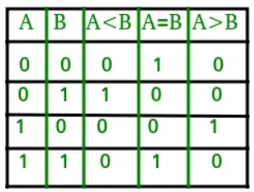
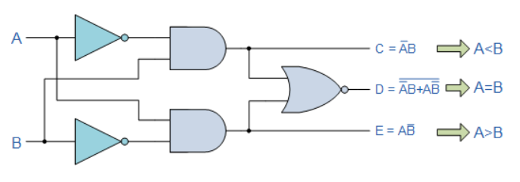
1-Bit Magnitude Comparator
A comparator used to compare two bits is called a single-bit comparator. It consists of two inputs each for two single-bit numbers and three outputs to generate less than, equal to, and greater than between two binary numbers.
The truth table for a 1-bit comparator is given below.
A>B: AB’
A<B: A’B
A=B: A'B' + AB

Slide 20
Verilog Code for 1-Bit Magnitude Comparator
module FA(input wireA,B, output wire C,D,E);
wire An, Bn,
assign An = ~A;
assign Bn = ~B;
assign C = An & B;
assign E = A & Bn;
assign D = C ~^ E;
endmodule

Slide 21
